Slide 1
Predicting MLB All-Stars
UNC Group 1
Christian Albertini
Hannah Shelton
Zach Mason
Folly Gbegnon

Slide 2
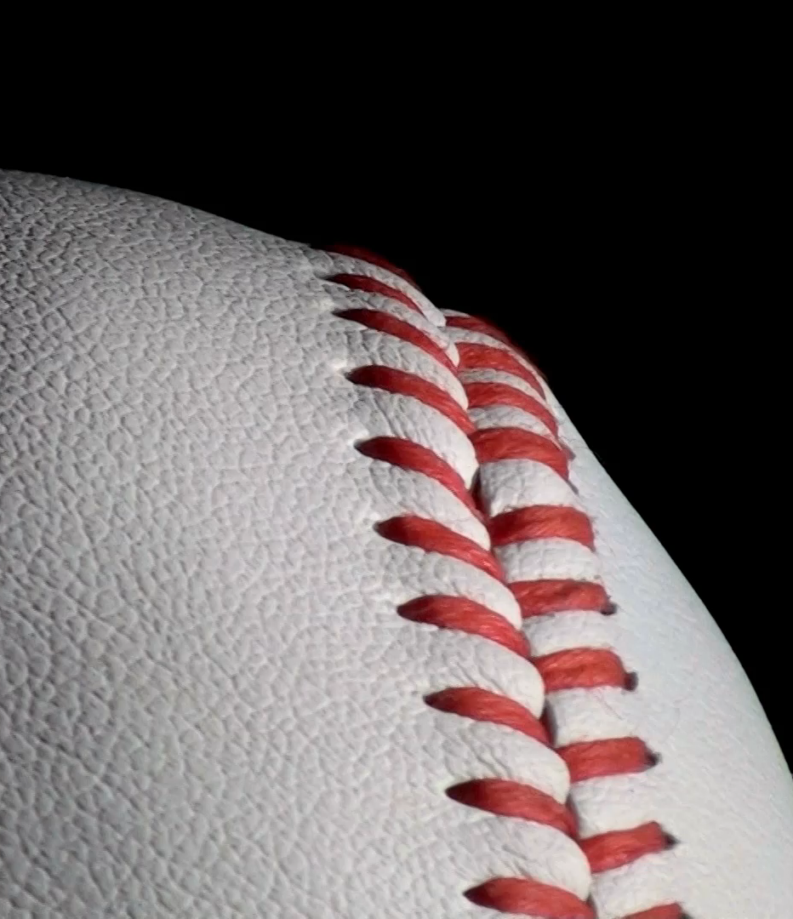
Executive Summary
The scope of our project is predicting MLB All-Stars based on end-of-season statistics
The source of our data is Baseball-Reference (link)
The requirements for this project where:
Find a problem worth solving, analyzing, or visualizing.
Use machine learning (ML) with the technologies we’ve learned.
You must use Scikit-learn and/or another machine learning library.
Your project must be powered by a dataset with at least 100 records.
You must use at least two of the programs used in class
This project resulted in:
Logistical Regression and Random Forest models
A SQL database
2100+ records retrieved
Visualizations
Ability to enhance model in the future

Slide 3
Project Goals
Retrieve data on baseball players end-of-season statistics from 2013 to 2023
Clean data and store in SQL database
Create model to predict which players were All-Stars each season
Create visualizations to display our efforts

Slide 4
Steps
Find datasets and decide what stats we need
Clean and merge datasets
Create SQL database to house cleaned dataset
Create and run machine learning models
Analyze results and change parameters of models to boost performance
Create visualizations to show results

Slide 5
Finding, cleaning and merging datasets
This step took us a significant portion of time because as we went along, we found new stats that could be helpful in making our model more accurate and would need to find the data needed and merge these datasets together
We used Baseball-Reference to acquire many end-of-season statistics for MLB players who played more than 80 games, such as hits, batting average, wins-above-replacement (WAR), and the final standings for their team at the end of the season
We used Pandas to clean and merge our datasets

Slide 6
Creating a sql database
We used pgAdmin and created a database to hold our cleaned dataset
We wrote a schema to create the table to house the data
We then imported the data into SQL

Slide 7
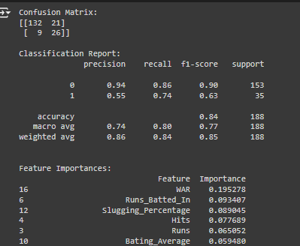
Creating, running and upgrading Ml models
We used Google Colab and wrote Jupyter Notebook files to run our models
We tested both logistic regression models and Random Forest models
As we ran more tests, we were able to improve our model’s performance by changing parameters, such as activation functions and number of estimators
We used SMOTE to help account for the imbalance in our dataset
This led to greater accuracy and recall, which was the primary statistic we were looking at
This is because we wanted our model to correctly predict All-Stars more than just getting who wasn’t an All-Star correct

Slide 8
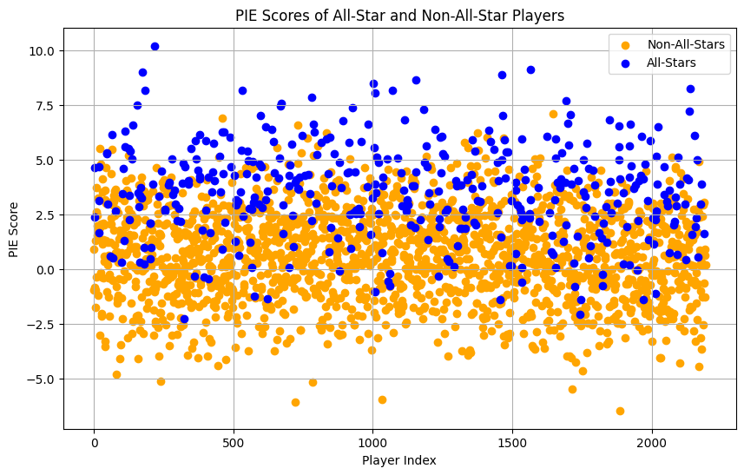
Creating visualizations
We then created visualizations to show how the model was looking at the datasets when it was learning

Slide 9
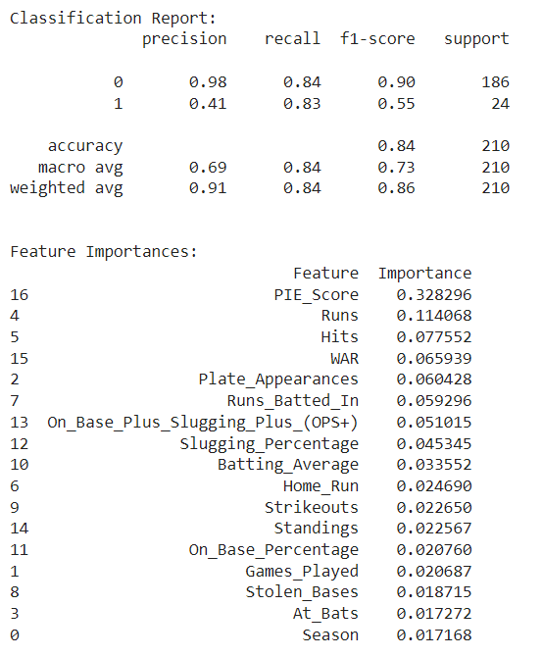
Our findings
We were able to create a model that achieved classification accuracy of over 75% consistently with weighted recall of around 80%
We attempted to run our model without SMOTE and found that our classification report numbers improved greatly, which shows that our model is better at finding non-All Star players when the dataset is imbalanced
Because All-Star selections are not solely on merit but are a fan-voted award, it is impossible for our model to account for players who were voted in but didn’t have great seasons with the data available to us, which prevents our model from being more accurate

Slide 10
Next steps
If possible, finding additional statistics could allow the model to improve its accuracy
Expanding the scope to include more than 2013-2023 could test our model in different ways, as changes in baseball as a sport could lead to some statistical seasons being All-Star caliber at one point and not at other times
We could also expand the dataset by reducing the minimum number of games played to be included from 80, which could let our model see more players and distinguish between All-Star and not better

Slide 11
THANK YOU
Christian Albertini
Hannah Shelton
Zach Mason
Folly Gbegnon

Slide 12
EFFECTIVE DELIVERY TECHNIQUES
This is a powerful tool in public speaking. It involves varying pitch, tone, and volume to convey emotion, emphasize points, and maintain interest.
Pitch variation
Tone inflection
Volume control
Effective body language enhances your message, making it more impactful and memorable.
Meaningful eye contact
Purposeful gestures
Maintain good posture
Control your expressions

Slide 13
The Power of
Communication

Slide 14
SELECTING VISUAL AIDS
ENHANCING YOUR PRESENTATION

Slide 15
NAVIGATING Q&A SESSIONS
Know your material in advance
Anticipate common questions
Rehearse your responses
Maintaining composure during the Q&A session is essential for projecting confidence and authority. Consider the following tips for staying composed:
Stay calm
Actively listen
Pause and reflect
Maintain eye contact

Slide 16

SPEAKING IMPACT
Your ability to communicate effectively will leave a lasting impact on your audience
Effectively communicating involves not only delivering a message but also resonating with the experiences, values, and emotions of those listening

Slide 17
DYNAMIC DELIVERY
METRIC | MEASUREMENT | TARGET | ACTUAL
Audience attendance | # of attendees | 150 | 120
Engagement duration | Minutes | 60 | 75
Q&A interaction | # of questions | 10 | 15
Positive feedback | Percentage (%) | 90 | 95
Rate of information retention | Percentage (%) | 80 | 85
Learn to infuse energy into your delivery to leave a lasting impression
One of the goals of effective communication is to motivate your audience

Slide 18


Slide 19
SPEAKING ENGAGEMENT METRICS
IMPACT FACTOR | MEASUREMENT | TARGET | ACHIEVED
Audience interaction | Percentage (%) | 85 | 88
Knowledge retention | Percentage (%) | 75 | 80
Post-presentation surveys | Average rating | 4.2 | 4.5
Referral rate | Percentage (%) | 10 | 12
Collaboration opportunities | # of opportunities | 8 | 10

